Slide 1

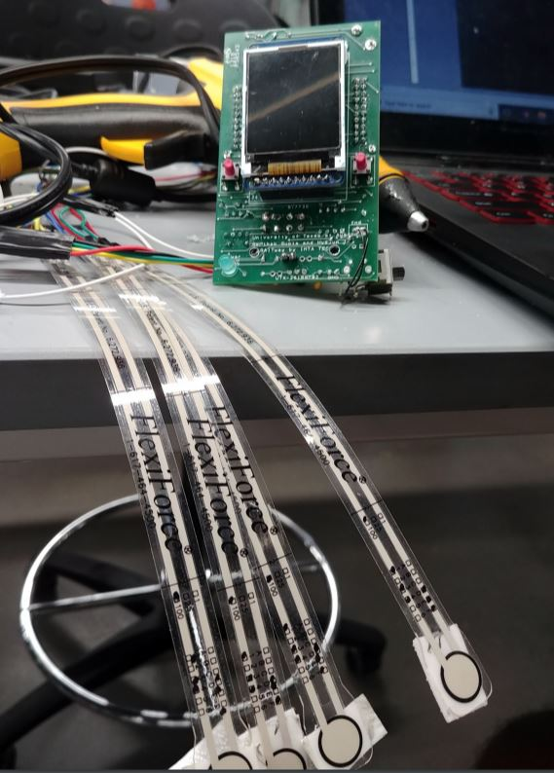
Moving Forward With GAITway
We have some goals that we would like to accomplish for this project through our future models:
Implement the device on both feet for a more accurate analysis of balance.
Have more testing modes so the user has more ways to test their own balance
Implement a communication server for the “patient” and the “physician”
Change to a wireless approach in which we use Bluetooth Low Energy to send sensor data to a phone application.
Explore opportunities to have our device be used in physical therapy for real patients
GAITway by IMTA TECH
GAITway
Hyejun Im and Sarthak Gupta
Prototype A
Demo Date: April 30th, 2018
Client: William Glanton
Let’s take a walk.

Slide 2
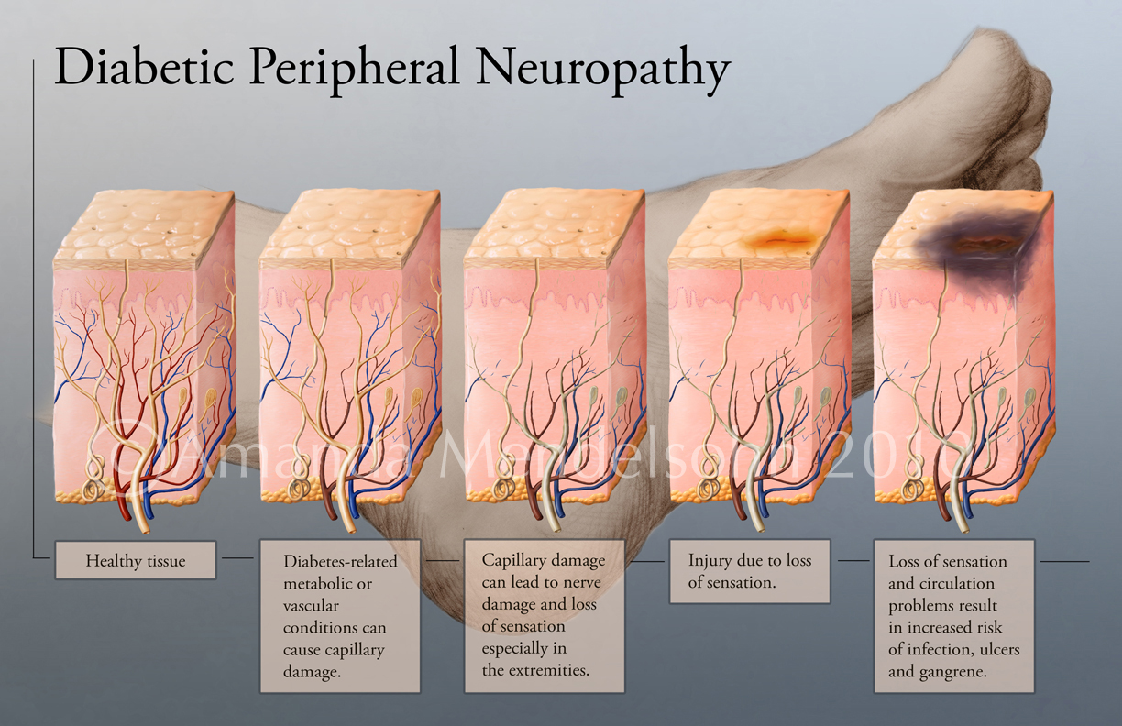
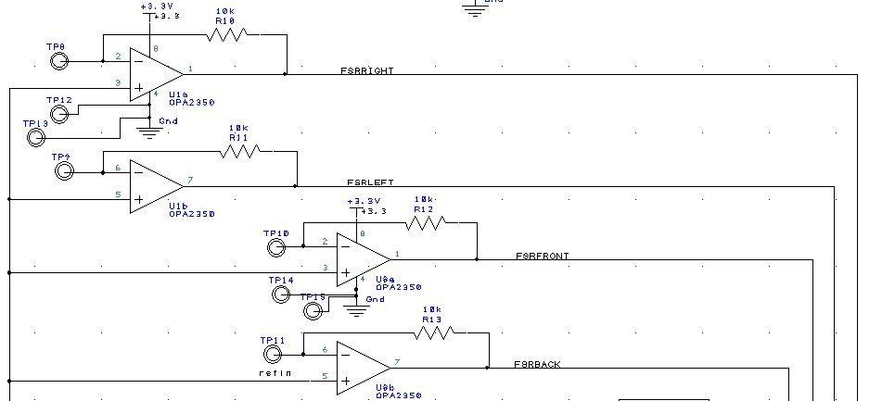
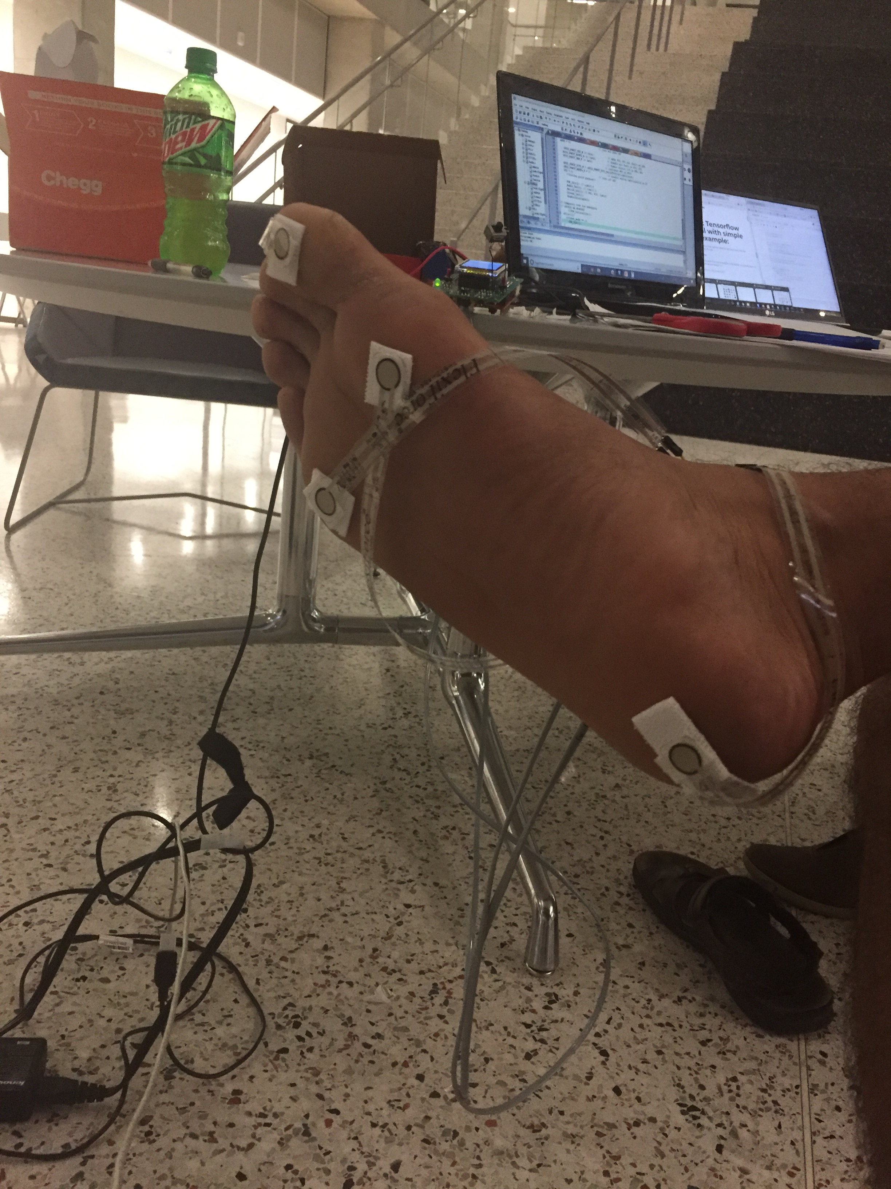
The Problem: Plantar Neuropathy
Our Solution: Audio Biofeedback System
We have designed a shoe insert that uses a very simple approach to tackle this problem. We interfaced four pressure transducers to monitor plantar weight distribution across the front, back, left, and right of the foot. This data will then be processed to give the user audio feedback according to the data that is output by the sensors.
There are several diseases that can cause nerve disorders throughout the body. For example, someone who has been diabetic for a long time could possibly encounter neuropathic symptoms. When these nerve disorders happen in a patient’s feet, it could lead to the loss of balance when standing or walking. This could further cause the person to fall and get injured.
We are using four force sensitive resistors to design our circuit. Each of them is connected to an amp to map the ADC conversion to somewhere between 1.53 V and 5 V (1.53 V is our reference voltage). The software will first ask the user to perform the test to the best of their ability, with assistance if needed. This is so our algorithm can save the person-specific calibrated values for each FSR. Then during testing, we use these values to compare to real time values that are being read from the sensors to detect if the user is off balance and then proceed to output to the DAC. The user will then hear the feedback and adjust their balance.

